Slide 1


Embedded C Programming at Sofcon India Pvt.Ltd.
Submitted to:
Prof. Rahul M. Patel
(ECE Dept.)
Submitted by:
Tirth Parmar
(200170111040)

Slide 2
Introduction Of C
C is a general-purpose programming language created by Dennis Ritchie at the Bell Laboratories in 1972.
It is a very popular language, despite being old.
C is strongly associated with UNIX, as it was developed to write the UNIX operating system.
The C language is a high-level language.
It provides a straightforward, consistent, powerful interface for programming systems. That's why the C language is widely used for developing system software, application software, and embedded systems.

Slide 3
What is Embedded C ??
Embedded C is most popular programming language in software field for developing electronic gadgets. Each processor used in electronic system is associated with embedded software.
Embedded C programming plays a key role in performing specific function by the processor.
In day-to-day life we used many electronic devices such as mobile phone, washing machine, digital camera, etc. These all device working is based on microcontroller that are programmed by embedded C.
In embedded system programming C code is preferred over other language because it is easy to understand, High Reliability, Scalability and Portability.

Slide 4
Comparison Of C and Embedded C
C Programming
Embedded C
It is a structural and general purpose programming language used by the developers to build desktop-based applications.
C is a high-level programming language.
This programming language is hardware independent.
The traditional or standard compilers are used to run the program
Embedded C is generally used to develop microcontroller-based applications.
Embedded C is just the extension variant of the C language.
Embedded C language is truly hardware dependent.
Here, we need a specific compiler that can help in generating micro-controller based results.

Slide 5
Requirement and Tasks
Requirement
Tasks
Keil Software
Proteus Professional 8
AT89C51 IC
Crystal Frequency: 11.0592MHz
Based on LED Blinkking/ Toggle/On-Off/Sequential
Based on Seven-Segment Display
Based on LCD
Based on DC Motor
Based on Stepper Motor

Slide 6
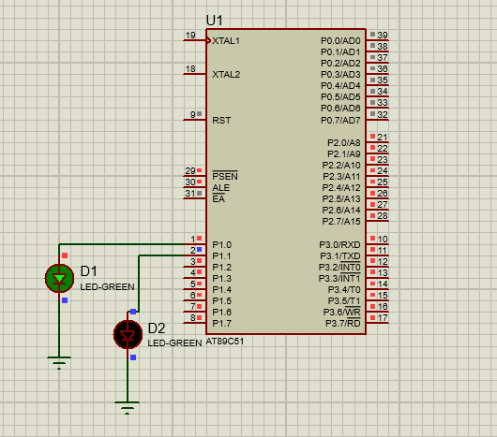
Task 1 : Based On LED Blinking

Slide 7
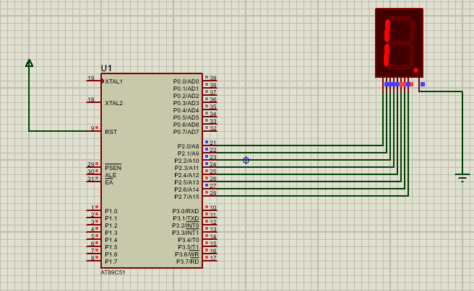
Task 2 : Seven-Segment Display

Slide 8
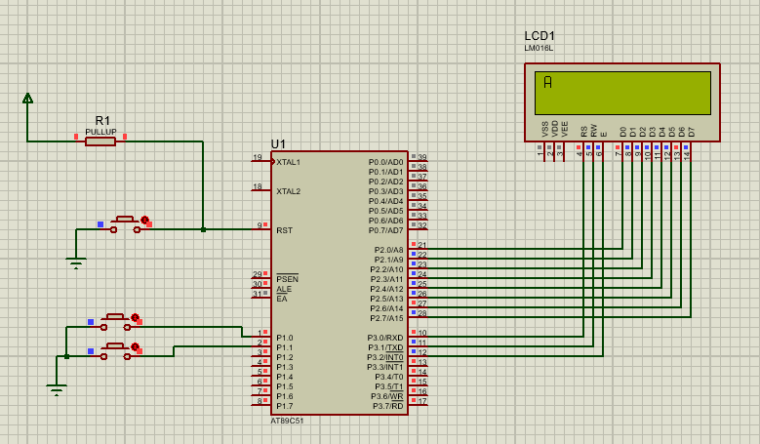
Task 3 : Based on LCD

Slide 9
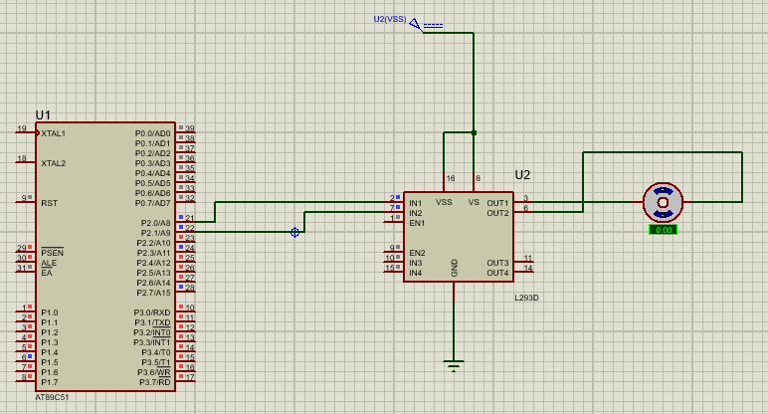
Task 4 : Based on DC Motor

Slide 10
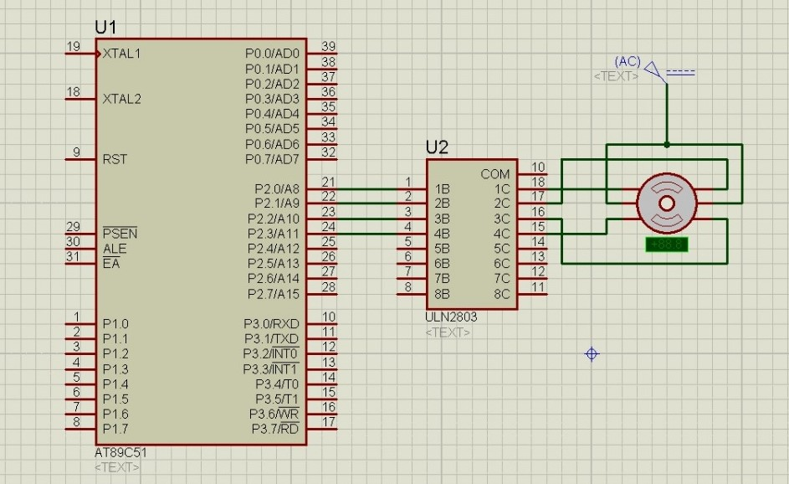
Task 5 : Stepper Motor

